Slide 1




SRM
INSTITUTE OF SCIENCE AND TECHNOLOGY,
CHENNAI.
18CSC201J
DATA STRUCTURES AND ALGORITHMS
Unit- V

Slide 2

SRM
INSTITUTE OF SCIENCE AND TECHNOLOGY,
CHENNAI.
Dijkstra's algorithm

Slide 3
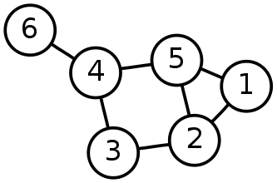
Shortest Path Problem
Single-Source Shortest Path Problem - The problem of finding shortest paths from a source vertex v to all other vertices in the graph.

Slide 4
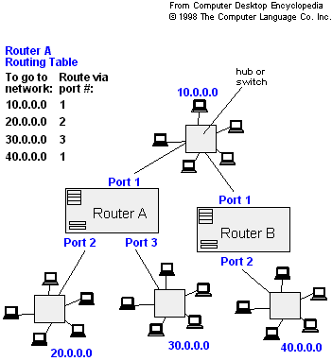
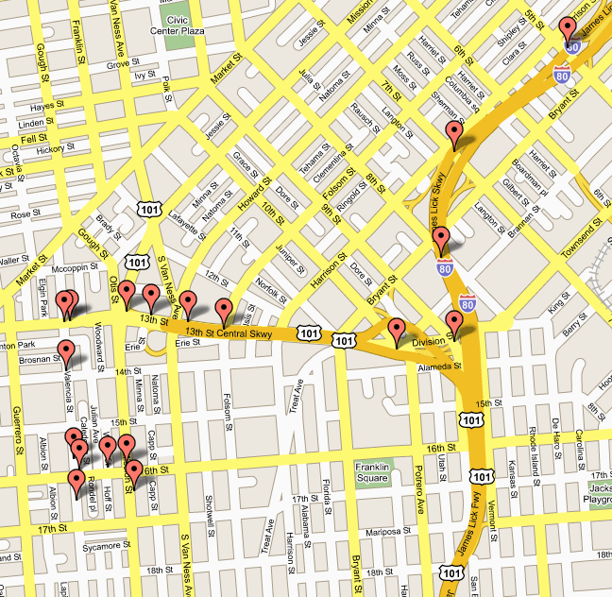
Applications
- Maps (Map Quest, Google Maps)
- Routing Systems

Slide 5
Dijkstra's algorithm
Dijkstra's algorithm - is a solution to the single-source shortest path problem in graph theory.
Works on both directed and undirected graphs. However, all edges must have nonnegative weights.
Input: Weighted graph G={E,V} and source vertex v∈V, such that all edge weights are nonnegative
Output: Lengths of shortest paths (or the shortest paths themselves) from a given source vertex v∈V to all other vertices

Slide 6
Approach
The algorithm computes for each vertex u the distance to u from the start vertex v, that is, the weight of a shortest path between v and u.
The algorithm keeps track of the set of vertices for which the distance has been computed, called the cloud C
Every vertex has a label D associated with it. For any vertex u, D[u] stores an approximation of the distance between v and u. The algorithm will update a D[u] value when it finds a shorter path from v to u.
When a vertex u is added to the cloud, its label D[u] is equal to the actual (final) distance between the starting vertex v and vertex u.

Slide 7
Dijkstra pseudocode
Dijkstra(v1, v2):
for each vertex v: // Initialization
v's distance := infinity.
v's previous := none.
v1's distance := 0.
List := {all vertices}.
while List is not empty:
v := remove List vertex with minimum distance.
mark v as known.
for each unknown neighbor n of v:
dist := v's distance + edge (v, n)'s weight.
if dist is smaller than n's distance:
n's distance := dist.
n's previous := v.
reconstruct path from v2 back to v1,
following previous pointers.

Slide 8
Example: Initialization
Let us consider A as the source node. Distance of all vertices except source is ∞
Distance(source) = 0
0
∞
A
2
B
4
1
3
10
∞
C
2
D
2
E
∞
5
8
∞
4
6
F
1
G
∞
∞
Pick vertex in List with minimum distance.

Slide 9
Update neighbour’s distance
Select the source node A and check the neighbour nodes it reaches. Update the weights of B and D as 2 and 1.
0
2
A
2
B
4
1
3
10
∞
C
2
D
2
E
∞
5
8
1
4
6
Distance(B) = 2
F
1
G
Distance(D) = 1
∞
∞

Slide 10
Now, select the node with minimum distance. Weights are 2 and 1 hence 1 is selected i.e., D is chosen
0
2
A
2
B
4
1
3
10
∞
C
2
D
2
E
∞
5
8
1
4
6
F
1
G
∞
∞

Slide 11
Neighbors of D are selected and their distances are updated.
Distance of C = Distance of D + weight of D to C = 1+ 2=3
Distance of E = Distance of D + weight of D to E = 1+ 2=3
Distance of F = Distance of D + weight of D to F = 1+ 8=9
Distance of G = Distance of D + weight of D to G = 1+ 4=5
0
2
A
2
B
4
1
3
10
C
2
D
2
E
3
3
5
8
1
4
6
F
1
G
9
5

Slide 12
Pick vertex in List with minimum distance and update neighbors.
B has the minimum distance. Neighbours of B are D and E.
Distance of D is not updated since D is already visited.
Previous distance of E = 3
New distance of E = 2+10 = 12
Distance of E not updated since it is larger than previously computed.
0
2
A
2
B
4
1
3
10
3
C
2
D
2
E
3
5
8
1
4
6
F
1
G
9
5

Slide 13
Pick vertex List with minimum distance and update neighbors. E is selected.
Distance of G not updated since it is larger than previously computed.
0
2
A
2
B
4
1
3
10
3
C
2
D
2
E
3
5
8
1
4
6
F
1
G
9
5

Slide 14
Pick vertex List with minimum distance and update neighbors.
C is selected. Neighbour is F.
Distance of F = Distance of C + weight of C to F = 3 + 5 = 8
0
2
A
2
B
4
1
3
10
3
C
2
D
2
E
3
5
8
1
4
6
F
1
G
8
5

Slide 15
Pick vertex List with minimum distance and update neighbors
G is selected. F is the neighbour.
Previous distance of F is 8.
Distance of F = Distance of G+weight from G to F = 5+1
Update the distance of F as 6.
0
2
A
2
B
4
1
3
10
3
C
2
D
2
E
3
5
8
1
4
6
F
1
G
6
5

Slide 16
F is selected and there are no neighbors to F. This is resultant the shortest path graph
0
2
A
2
B
4
1
3
10
3
C
2
D
2
E
3
5
8
1
4
6
F
1
G
6
5

Slide 17
References:
1. A.V.Aho, J.E Hopcroft , J.D.Ullman, Data structures and Algorithms, Pearson Education, 2003
2. Reema Thareja, Data Structures Using C, 1st ed., Oxford Higher Education, 2011

Slide 18
Thank You

